Slide 1
Diagrams for Interpretable ML Method

Slide 2
Rule Trees
1. Rules are evaluated from top to bottom.
Default Rule
(behaviors and optional criterion)
Child Rule 1
(behaviors and optional criterion)
Child Rule 2
(behaviors and optional criterion)
Child Rule 3
(behaviors and optional criterion)
Child Rule 1
(behaviors and optional criterion)

Slide 3
Rule Trees
2. A rule first evaluates its criteria, then, if the set of criteria matches, executes its behaviors and nested children.
Default Rule
(behaviors and optional criterion)
If criteria matches
Execute behavior and nested children
Child Rule 1
(behaviors and optional criterion)
Child Rule 2
(behaviors and optional criterion)
Child Rule 3
(behaviors and optional criterion)
Child Rule 1
(behaviors and optional criterion)

Slide 4
Rule Trees
3. If any behavior is specified more than once within a set of executing rules, the last one overrides those that precede it.
Default Rule
(behaviors and optional criterion)
If any behavior is specified more than once within a set of executing rules
Default Rule
(behaviors and optional criterion)
Child Rule 1
(behaviors and optional criterion)
Child Rule 2
(behaviors and optional criterion)
Child Rule 3
(behaviors and optional criterion)
Child Rule 1
(behaviors and optional criterion)
Child Rule 2
(behaviors and optional criterion)
Child Rule 3
(behaviors and optional criterion)
Child Rule 1
(behaviors and optional criterion)
the last one overrides those that precede it.

Slide 5
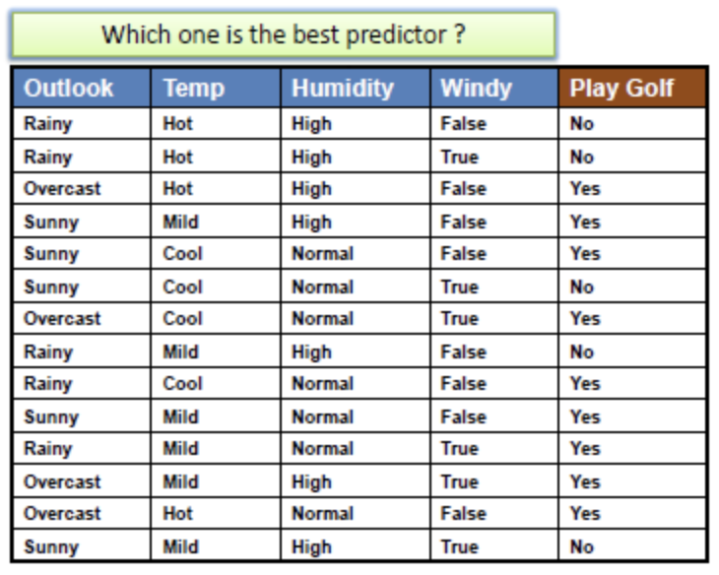
OneR
For each predictor, For each value of that predictor, make a rule as follows; Count how often each value of target (class) appears

Slide 6
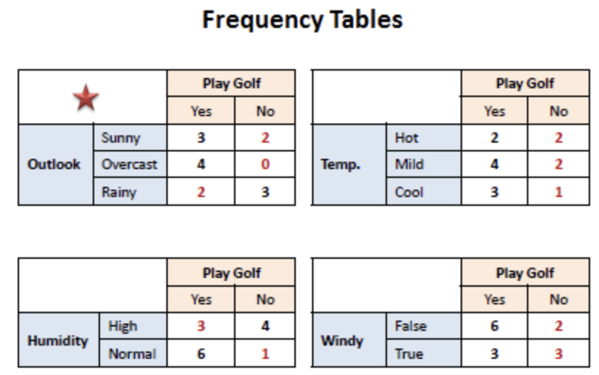
OneR
2. For each predictor, For each value of that predictor, make a rule as follows; Find the most frequent class

Slide 7
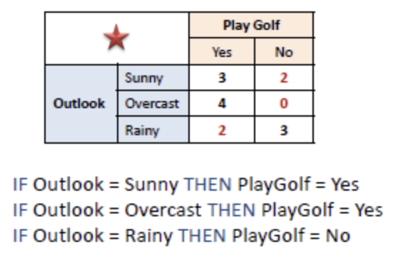
OneR
3. For each predictor, For each value of that predictor, make a rule as follows; Make the rule assign that class to this value of the predictor

Slide 8
OneR
4. For each predictor, Calculate the total error of the rules of each predictor

Slide 9
OneR
5. Choose the predictor with the smallest total error.

Slide 10
Greedy Rule List
Greedily splits on one feature at a time along a single path
Features 1
Features 2
Features 3
Category 1
Category 2
Category 3
Rule that maximize the probability of class 1

